Slide 1

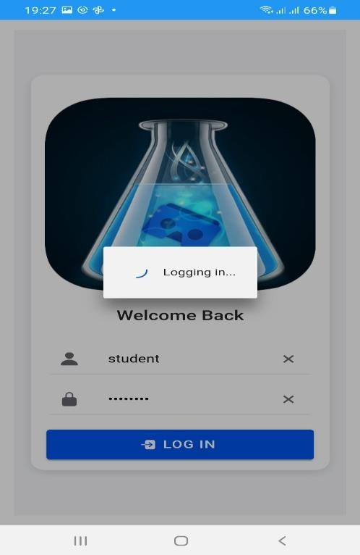
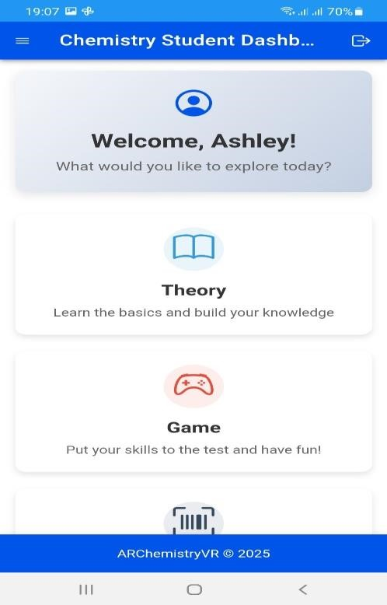
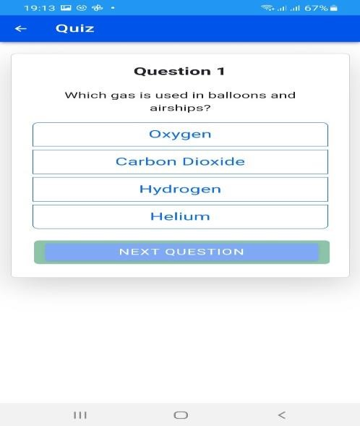
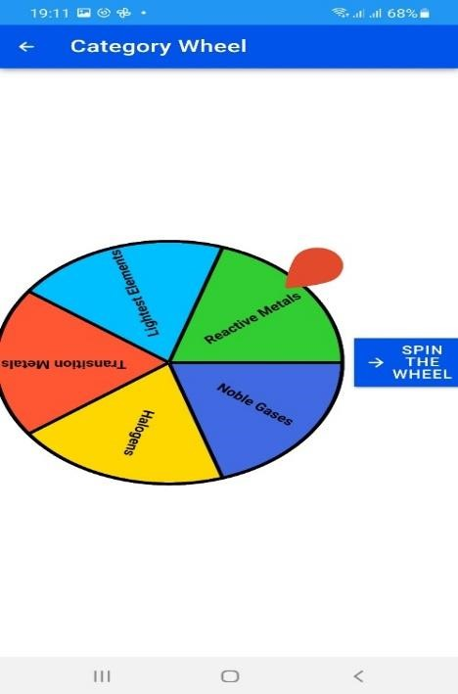
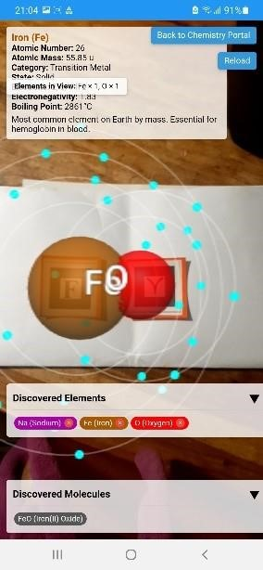
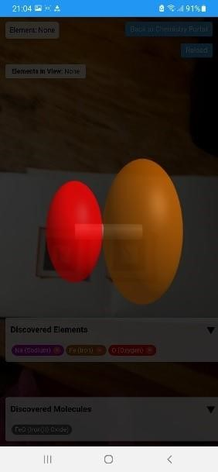
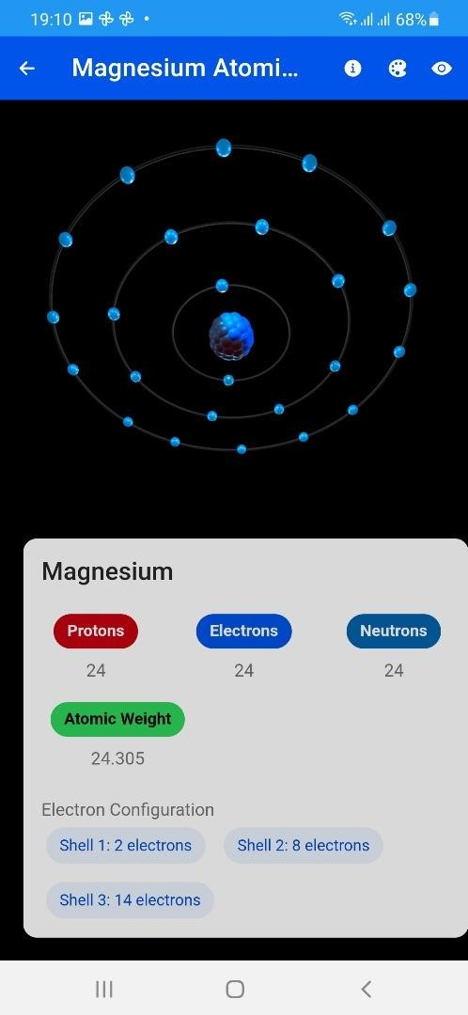
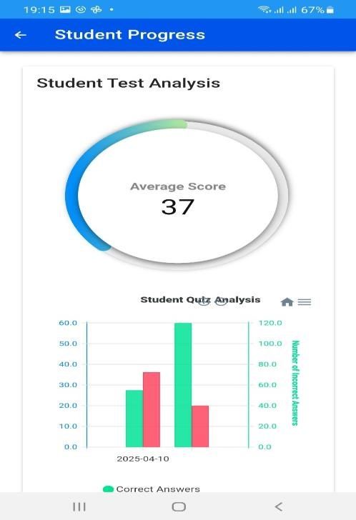
Augmented Reality in Chemistry
Ashley Ruvarashe Zvinavashe - Software Engineering Department
1. Abstract
3. Problem definition
6. Screenshots
7. Conclusion
Chemistry education is frequently hindered by the abstract nature of its core concepts, leading to difficulties in visualization and comprehension, particularly at high school . This project proposes the development of an Augmented Reality (AR) mobile application designed to revolutionize the learning experience by providing immersive and interactive visualizations of chemical phenomena. The application aims to address the challenges of visualizing complex molecular structures, and exploring bonding mechanisms in real-time. By leveraging AR technology, students will be able to interact with 3D models of molecules, and explore chemical processes in a tangible, engaging manner. This platform will cater to diverse learning styles by offering interactive, visual, and kinesthetic learning experiences, thereby enhancing comprehension and retention. Ultimately, this project seeks to transform chemistry education by making it more accessible, engaging, and enjoyable, fostering a deeper understanding of fundamental chemical principles.
Recent and ongoing studies continue to emphasize on the relevance of teaching styles in ensuring that students learn as expected of them by the facilitator. The current system is not student centric , this is to say that students are not participants during the learning and teaching process they are more of recipients of what is given to them . This can result in lack of engagement with the student .
To add to that students have different learning styles, namely – visual, auditory and kinesthetics just to mention a few. Teaching styles used in institutions should cater for a wide spectrum of learning styles to ensure inclusivity.
In the context of Zimbabwe’s Education 5.0 model, which calls for a transformation from passive learning to innovation-driven, practical, and technology-integrated education, there is a clear need for tools that not only enhance learning outcomes but also align with national goals of industrialization and technological advancement. The lack of interactive, immersive tools in chemistry education presents a gap that must be addressed to fulfil the innovative and practical thrust of Education 5.0.
The development and testing of the AR Chemistry application has yielded promising results, indicating its potential to enhance chemistry education within the local context.
Enhanced Engagement and Visualization: The Observations during simulated usage and planned acceptance testing suggest that this immersive approach has the potential to increase student engagement and improve their spatial understanding of molecular structures and reactions.
Functional Core Modules: The major modules, including 3D Model Loading and Rendering, and Assessment Handling, were implemented and demonstrated basic functionality through unit and module testing. Pseudo-code and code snippets illustrate the core logic within these modules.
Robust Testing Strategy: Unit and module testing provided a foundation of confidence in the individual components and their basic interactions. Integration testing aimed to ensure seamless data flow between modules, and system testing targeted overall application stability and functionality.
2. Introduction
4. Objectives
8. Future Works
Chemistry, a key scientific discipline, presents challenges for learners due to its abstract concepts and complex structures. Traditional teaching methods often struggle to illustrate the full three dimensional nature of chemical phenomena. This project aims to overcome these obstacles by creating an innovative Augmented Reality mobile app that brings chemistry to life.
Through this application, students will access an engaging and hands-on learning journey, allowing them to interact with and visualize 3D molecular structures, and delve into bonding processes using captivating AR features. By harnessing AR capabilities, this endeavor aims to revolutionize the teaching of chemistry, enhancing accessibility, engagement, and effectiveness for high school students.
The quote by Confucius “ I hear and I forget. I see and I remember. I do and I understand” illustrates the importance of active participation from students. This quote further elucidates the limitations of passive absorption of information.
To develop a mobile application that allows students to visualize content from chemistry using Augmented Reality .
To Integrate gamified learning experiences into the application.
To incorporate progress tracking and analytics in the mobile application for the student.
Building upon the foundation laid by this project, several avenues for future work can be explored:
Expansion of AR Interactions: Explore more advanced AR interactions, such as allowing students to virtually "mix" chemicals and observe reactions in their physical space, or to build complex molecules by connecting virtual atoms.
Integration with Learning Management Systems (LMS): Explore the potential to integrate the AR Chemistry application with existing LMS platforms used in Zimbabwean schools to streamline assignment distribution, progress tracking, and grade management.
Exploration of AI-Powered Learning Support: Investigate the potential integration of AI powered features, such as intelligent feedback on assessments or personalized learning recommendations based on student progress.
5. Methodology
To achieve these objectives, the researcher used a range of software tools and technologies, including:
React.js , javascript (ES6+) and three.js for the user interface
Git for version control
SQLite for the database
Three.js for Augmented Reality Development.
Jest and Mocha for testing.
The researcher followed an Agile development methodology, getting regular feedback from stakeholders (lecturers and students) to ensure that the application meets their needs.
Supervisor – Mr. W. Makondo

